Slide 1

Welcome to POL 103!
That’s me, your professor, Reuben Kline.
In addition to comparative politics, I spend my time cooking, doing martial arts, and trying to get my son to listen to me. If you’re interested in the research I do as a scholar, check out my homepage.
These are challenging times. I am sympathetic to all of the challenges you face. But, to help you out, you need to communicate with me and let me know the problems you’re having.

Slide 2
Office Hours
I will hold (in-person) office hours Mondays 10am-12pm. Most Mondays and Wednesdays you’ll also be able to catch me in person in my office (Social and Behavioral Sciences S739). Email me ahead of time to make sure I’m available.

Slide 3
Teaching Assistant
Tom Campbell is a PhD student and will be our TA. He will hold in-person office hours 11am-1pm Mondays in his office, SBS S766.
If you can’t make either of our office hour times, you can reach out to one of us and schedule an appointment.

Slide 4
Foundations of Comparative Politics Chapter 1
Introduction

Slide 5
Introduction
In December 2010, Mohamed Bouazizi set himself on fire to protest treatment by local officials in Tunisia.
Protests spread throughout Tunisia, to other states in the Middle East and North Africa
Several long-standing dictators were removed from power in the Arab Spring.

Slide 6
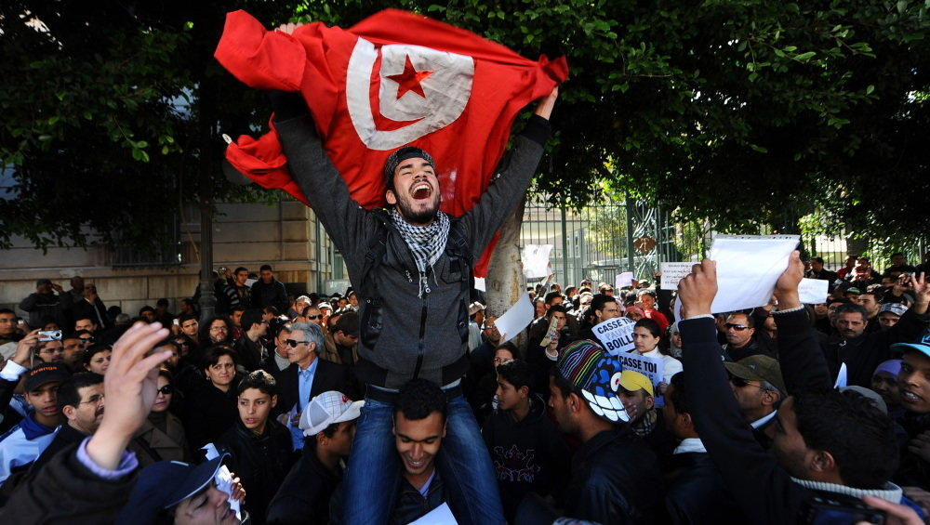
Arab Spring: Tunisia
Image credit: Fethi Belaid/AFP/Getty Images

Slide 7
Introduction
Was this the start of a new wave of democratization?
We must be cautious, since there are multiple parallels to the European revolts in 1848.
Multiple tyrants were ousted.
Yet revolution was followed by repression.
Social and political change occurs in ways that are difficult to predict!
But similar social and economic forces were at play in both cases

Slide 8
Introduction
Scholars have attempted to explain why the Arab Spring has not blossomed into a new wave of democracy.
Only three countries (Egypt, Tunisia, and Yemen) have seen an incumbent autocrat removed as a result of domestic political pressure.
Only Tunisia has made progress toward becoming a democracy.

Slide 9
What Is Comparative Politics?
There are various definitions that have been used throughout the years.
Definition 1: An influential textbook by LaPalombara (1974) titled, Politics Within Nations distinguishes international politics from comparative politics.
Comparative politics is the study of political phenomena that occur predominantly within countries.
International politics is the study of political phenomena that occur predominantly between countries.

Slide 10
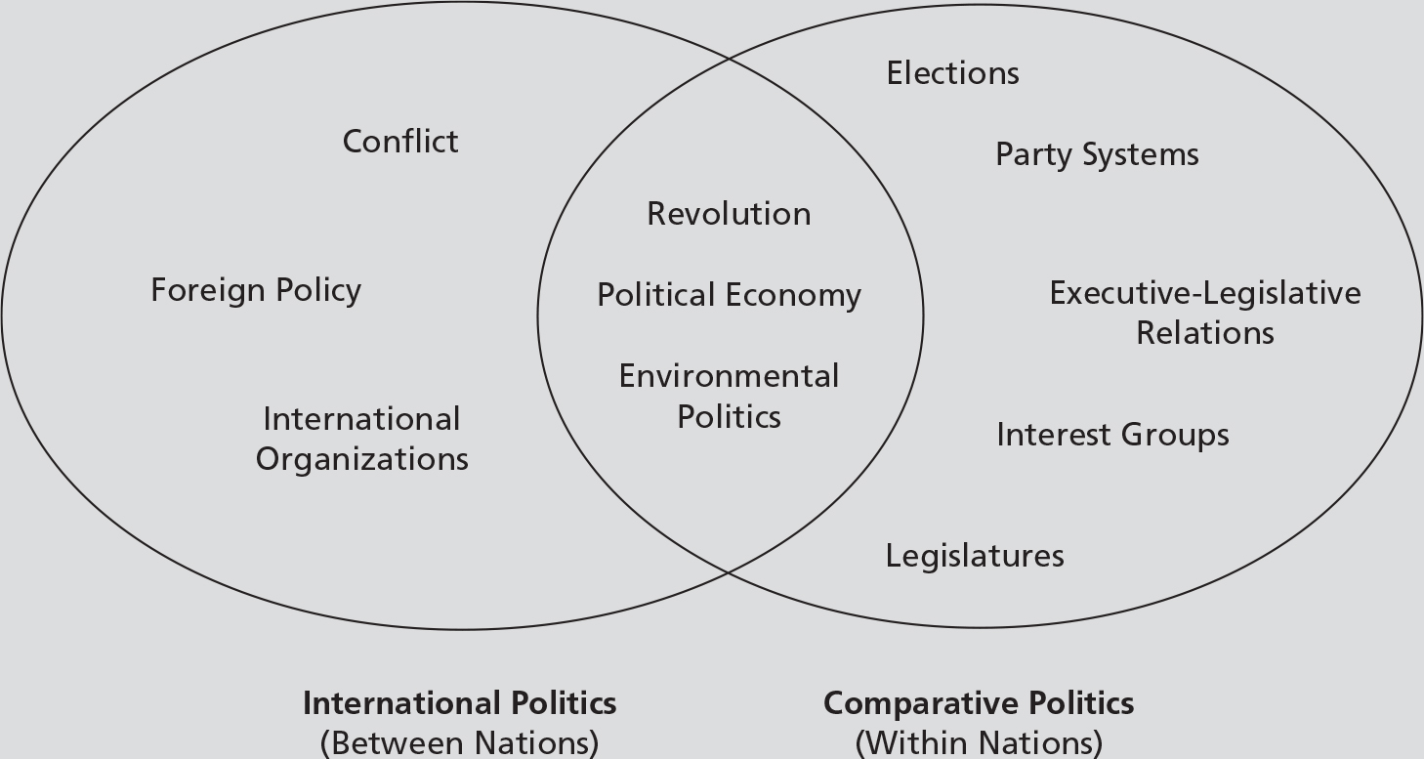
What Is Comparative Politics?

Slide 11
What Is Comparative Politics?
Definition 2:
Comparative politics is the study of politics in every country except the one in which the student resides.
It’s the study of “the rest of the world”
This is why “American politics” is treated as a separate subfield of political science in the United States.
From a scientific perspective such a distinction is kind of silly.

Slide 12
What Is Comparative Politics?
Definition 3:
Comparative politics is the study of political phenomena through the “comparative method.”
Dates back to Aristotle’s attempt to classify different constitutional forms and compare them.
But, most science (at least political science) involves comparison, so this definition isn’t particularly useful.

Slide 13
What Is Comparative Politics?
Comparative politics has been defined in several ways
The study of political phenomena within countries
The study of political phenomena in every country except the one in which you reside
The study of political phenomena through the comparative method
Our working definition: comparative politics is the study of politics predominantly within countries.

Slide 14
What is Politics?
We defined comparative politics, but what is politics?
Several definitions:
”Who gets what, when and how” (Lasswell)
Study of power
Study of government
We’ll think of politics as having to do with power and influence. But even that is broader than it seems, according to CGG (p. 33):
Politics comprises the subset of human behavior that involves the use of power…power is involved whenever individuals can’t accomplish their goals without either trying to influence the behavior of others or trying to wrestle free from the influence exerted by others.

Slide 15
What is Politics?
Politics isn’t limited to government. Politics happens whenever people need to interact with and influence others to get what they want…so politics is everywhere.
It happens when people’s objectives are intertwined and interdependent — so to get what you want in politics you need to think about what others want and how they can help or hinder you in getting it.
In other words, politics requires strategic thinking
Game theory is the scientific study of strategic behavior… we will be using basic game theory a lot in this course…

Slide 16
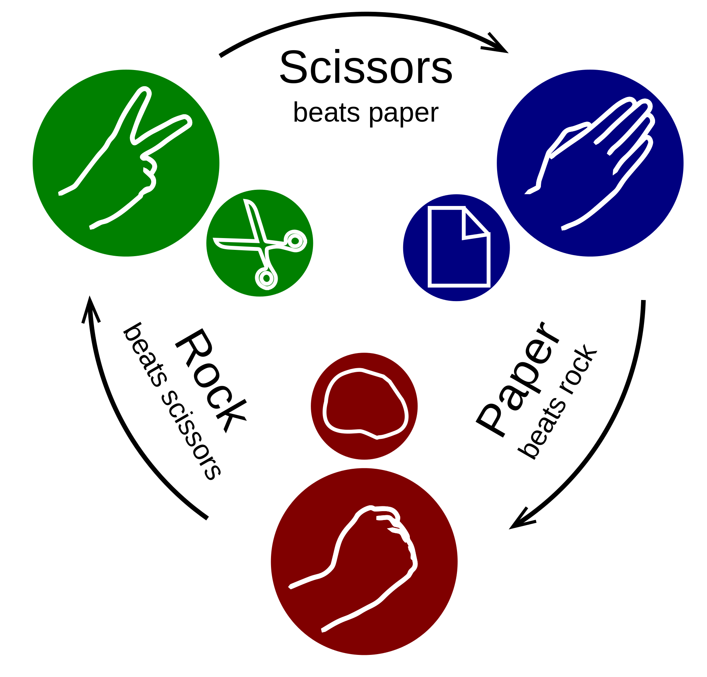
Politics?

Slide 17
Overview of the Book
The authors’ goal in writing this book is to provide answers that are relevant to the problems motivating the study of comparative politics today and that are reliable
State failure
Economic determinants of democracy
Cultural determinants of democracy
What’s so good about democracy anyway?
Institutional design

Slide 18
The Approach Taken in This Book
Many introductory comparative politics texts are organized around a sequence of individual country studies.
This traditional approach has some limitations.
This text takes a more conceptual approach that aims to introduce you to what comparative political scientists spend most of their time doing and to give you the knowledge to evaluate the debates in our discipline.

Slide 19
Which textbook?
The book for the course is by Clark, Golder and Golder.
The problem is that they've written two different books that have almost the same title.
First has 3 editions: Principles of Comparative Politics.
Second book called: Foundations of Comparative Politics.
Foundations is required for the course
Principles covers all that Foundations does, so if you had a 2nd or 3rd edition of Principles that would work.
Best choice still is Foundations

Slide 20
Chapter 2
What Is Science?

Slide 21
Introduction
Comparative politics is a subfield of political science.
But, what is political science?
Political science is the study of politics in a scientific manner.

Slide 22
What Is Science?
Is science a body of knowledge or collection of facts?
No—We would not be able to appeal to science to justify our knowledge of the world without falling into the following circular reasoning.
The body of knowledge that we call “scientific” may well be a product of science, but it is not science itself.

Slide 23
What Is Science?
Science is a method for provisionally understanding the world.
Science is a quest for knowledge that relies on criticism.
The thing that allows for criticism is the possibility that our claims, theories, hypotheses, ideas, and the like could be wrong.

Slide 24
What Is Science?
No amount of experimentation can ever prove me right. A single experiment can prove me wrong.
- Albert Einstein (probably?)

Slide 25
What Is Science?
What distinguishes science from “nonscience” is that scientific statements must be falsifiable
Falsifiability isn’t everyone’s view of science, but it is the dominant one
There must be some imaginable observation or set of observations that could falsify or refute them.
All scientific statements must be potentially testable.
This does not mean that our theories will ever be falsified, just that there is a possibility that they could be falsified.

Slide 26
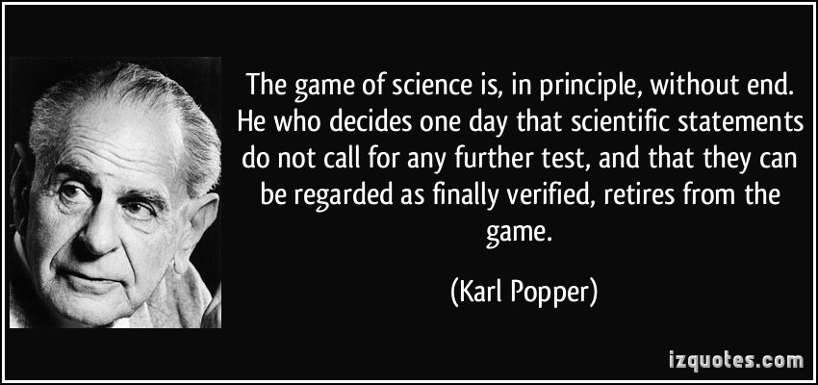
Karl Popper: falsifier-in-chief

Slide 27
What Is Science?
What sorts of statements are not falsifiable?
Tautologies are not falsifiable because they are true by definition
Statements about unobservable phenomena
This does NOT mean that nonscience is nonsense or that these claims are necessarily false

Slide 28
The Scientific Method
The scientific method describes the process by which scientists learn about the world.
There are various steps that apply to the scientific method.

Slide 29
The Scientific Method
Step 1: Question
The first step is to observe the world and come up with a question or puzzle.
Example: What is the relationship between a country’s wealth and its status as a democracy?

Slide 30
The Scientific Method
Step 2: Theory or Model
The next step is to come up with a theory or model to explain the question.
Theory
A set of logically consistent statements that tell us why the things we observe occur. A theory is sometimes referred to as a model or an explanation.

Slide 31
The Scientific Method
Step 3: Implications (Hypotheses)
This step of the scientific process requires that we deduce implications from the model other than those we set out to explain in the first place.
Good models provide many different implications.

Slide 32
The Scientific Method
Step 4: Observe the World (Test Hypotheses)
The fourth step is to examine whether the implications of the model are consistent with observation.
We may need to conduct a “critical test” that allows us to use observation to distinguish between two or more competing explanations of the same phenomenon.

Slide 33
The Scientific Method
Step 5: Evaluation
If we observe the implications deduced from our theory, then we say that our theory is corroborated.
We do not say that our theory is proven.
We then continue to look for evidence that would contradict our theory.
If we fail to observe the implications deduced from our theory, then our theory is probably wrong.

Slide 34
An Introduction to Logic
Throughout our lives, we are confronted by people trying to convince us of certain things through arguments.
It is important for you to be able to know if these arguments are valid or not.

Slide 35
An Introduction to Logic
Valid and Invalid Arguments
An argument is a set of logically connected statements, typically in the form of a set of premises and a conclusion.
A premise is a statement that is presumed to be true within the context of an argument leading to a conclusion.
A conclusion in an argument is a claim that is thought to be supported by the premises.

Slide 36
An Introduction to Logic
Valid and Invalid Arguments
An argument is valid when accepting the premises compels us to accept its conclusion.
An argument is invalid if, when we accept the premises, we are free to accept or reject its conclusions.
One way to represent an argument is in the form of a categorical syllogism that consists of a major premise, a minor premise, and a conclusion.

Slide 37
An Introduction to Logic
Valid and Invalid Arguments
Categorical syllogism
The major premise is typically a conditional statement such as “If P, then Q.”
The “If” part is called the antecedent.
The “then” part is called the consequent.
Example: “If a country is wealthy, then it will be a democracy.”
Each of the four types of categorical syllogism begins with this same major premise (or one like it).

Slide 38
An Introduction to Logic
Valid and Invalid Arguments
Categorical syllogism
The minor premise consists of a claim about either the antecedent or the consequent of the conditional statement.
The conclusion is a claim that is thought to be supported by the premises.

Slide 39
An Introduction to Logic
Valid and Invalid Arguments
Categorical syllogism
There are four types of categorical syllogisms
Arguments that affirm the antecedent
Arguments that deny the antecedent
Arguments that affirm the consequent
Arguments that deny the consequent
Notes:
Which of these types are valid?

Slide 40
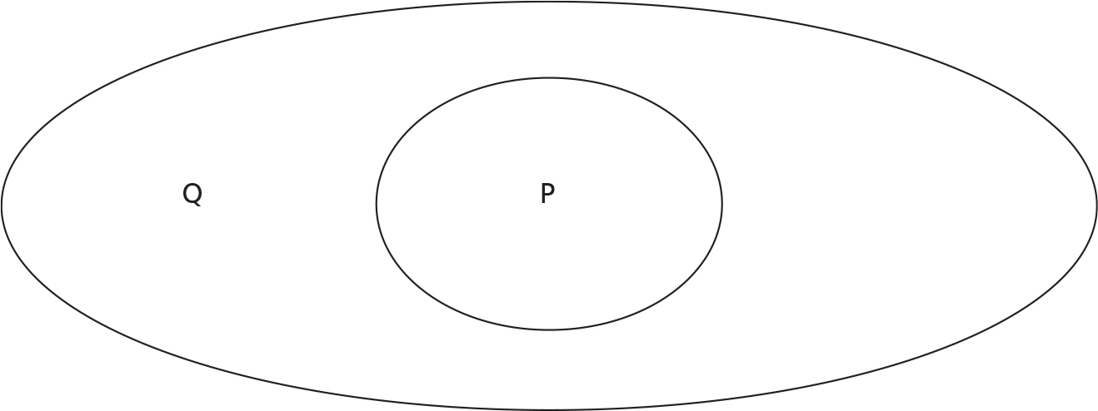
An Introduction to Logic
Valid and Invalid Arguments
Categorical syllogism

Slide 41
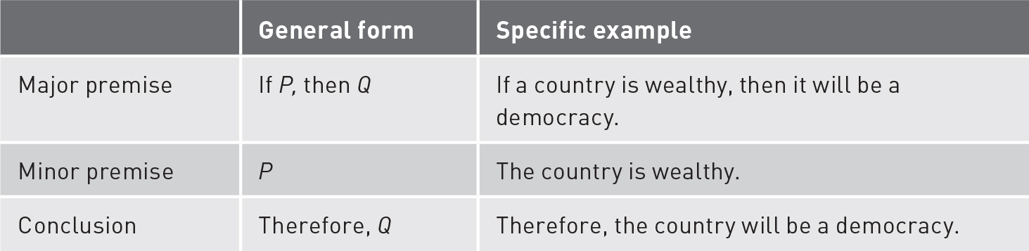
An Introduction to Logic
Valid and Invalid Arguments
Affirming the Antecedent
Notes:
Valid because There are no wealthy non-democracies

Slide 42
An Introduction to Logic
Valid and Invalid Arguments
Categorical syllogism
Notes:
Valid because There are no wealthy non-democracies

Slide 43
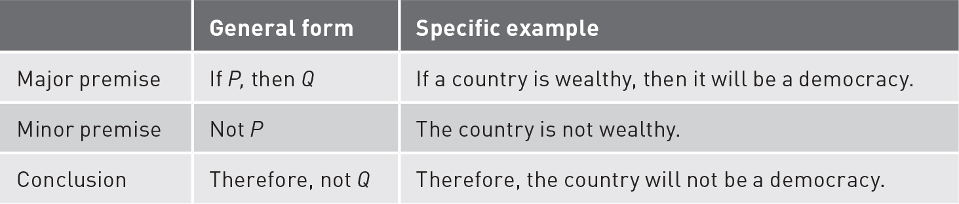
An Introduction to Logic
Valid and Invalid Arguments
Denying the antecedent
Notes:
Invalid because There are non-wealthy democracies

Slide 44
An Introduction to Logic
Valid and Invalid Arguments
Categorical syllogism
Notes:
Invalid because There are non-wealthy democracies

Slide 45
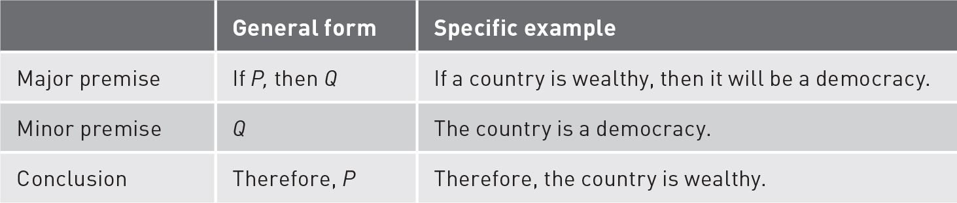
An Introduction to Logic
Valid and Invalid Arguments
Affirming the Consequent
Notes:
Invalid because There are non-wealthy democracies

Slide 46
An Introduction to Logic
Valid and Invalid Arguments
Categorical syllogism
Notes:
Invalid because There are non-wealthy democracies

Slide 47
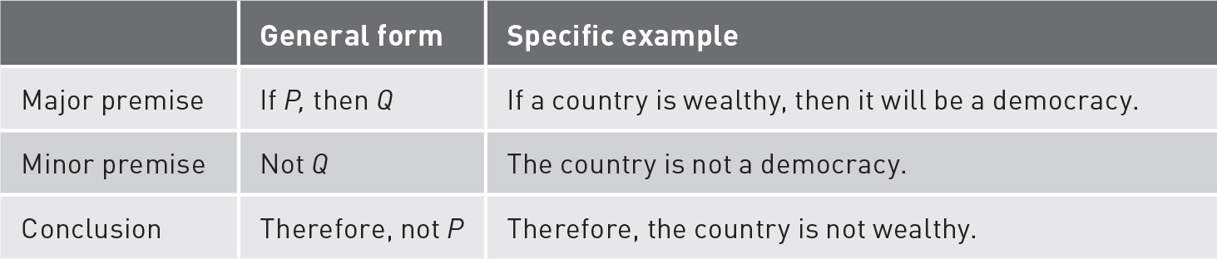
An Introduction to Logic
Valid and Invalid Arguments
Denying the consequent
Notes:
Valid because There are no wealthy non-democracies

Slide 48
An Introduction to Logic
Valid and Invalid Arguments
Categorical syllogism
Notes:
Valid because There are no wealthy non-democracies

Slide 49

An Introduction to Logic
Valid and Invalid Arguments
Categorical syllogism

Slide 50
An Introduction to Logic
Testing Theories
It’s important for you to be able to distinguish between valid and invalid arguments.
This brief introduction to logic is important because it tells us something about the way that scientists test their theories and explanations.

Slide 51
Are wealthy countries more democratic?
Living in a dictatorship is risky: if you’re friends with the dictator, you’re good, if not…well
Living in a democracy is less risky. Democratic leaders need broader support and therefore need to distribute their goodies more broadly…democratic middle class
Rich people are less likely to take risks because they have more to lose. Countries with rich people should therefore be more likely to be democracies.

Slide 52
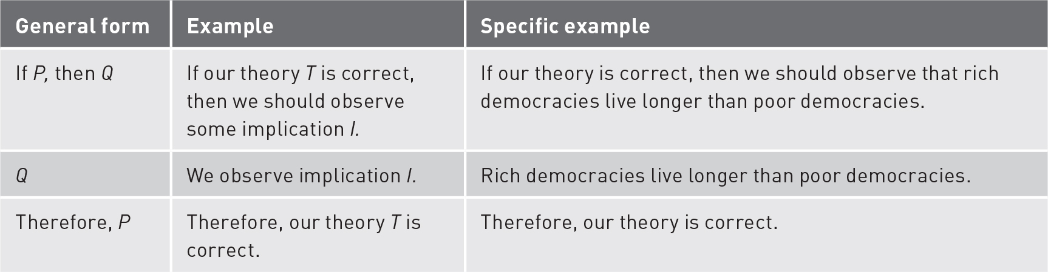
An Introduction to Logic
Testing Theories

Slide 53
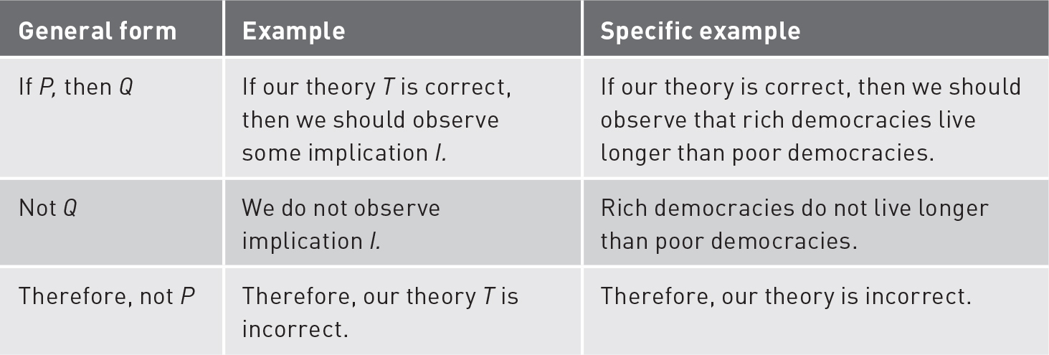
An Introduction to Logic
Testing Theories

Slide 54
An Introduction to Logic
Testing Theories
There is an asymmetry in the logical claims that can be made on the basis of “confirming” and “disconfirming” cases.
When an implication of our theory is confirmed, the most we can say is that the theory may be correct.
When an implication of our theory is disconfirmed, we are compelled to conclude that our theory, or at least some important part of it, is wrong.

Slide 55
An Introduction to Logic
Testing Theories
Falsification is an approach to science in which scientists generate or “deduce” testable hypotheses from theories designed to explain phenomena of interest.

Slide 56
An Introduction to Logic
Testing Theories
Deductive learning: formulates expectations based on a theory and then finds observations
Inductive learning: start with observations, find patterns that can be used to generate explanations
Induction is problematic because it relies on affirming the consequent.
The theory may never be exposed to falsificationism.

Slide 57

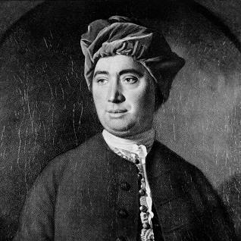

An Introduction to Logic
This is David Hume’s famous problem of induction…

Slide 58
Myths About Science
Science leads to certain and verifiable truth
This is not the best way to think about science.
The best science can hope to offer are tentative statements about what seems reasonable in light of the best available logic and evidence.
We use the scientific method because it’s the best tool available to interrogate our beliefs about the world.

Slide 59
Myths About Science
Science can be done only when experimental manipulation is possible.
For theories to be scientific, they need only be falsifiable.
There’s no claim that the tests of these theories need to be carried out in an experimental setting.

Slide 60
Myths About Science
Scientists are value neutral.
The scientific method itself is value neutral.
We have to be very careful about the limits of our knowledge.
Much of science is about carefully estimating our uncertainty (e.g. confidence intervals in statistical estimation).

Slide 61
Myths About Science
Politics cannot be studied in a scientific manner.
The study of politics generates falsifiable claims and hence generates scientific statements.
These theories of politics can be tested just like any other scientific theory.

